Slide 1





Using qualitative and quantitative data to explore how community factors influence early child development:
Big Data and Small Data
Professor Sharon Goldfeld
Centre for Community Child Health
February 2-3, 2017
Cities4Kids: Small Children, Big Cities – Urban95
New Delhi, India

Slide 2
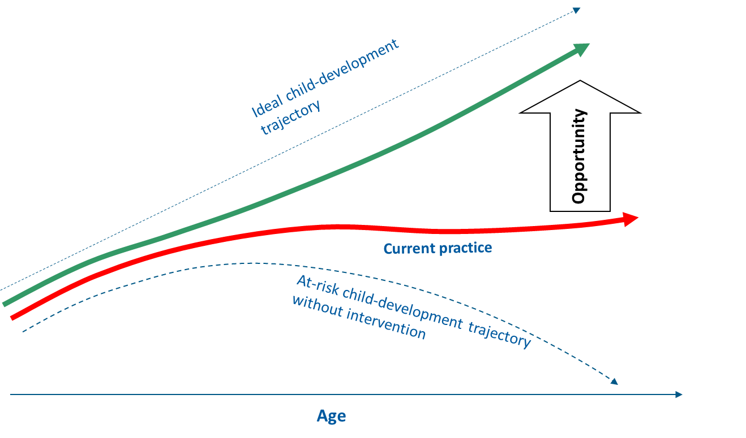
Can we make a sustainable difference to ECD?

Slide 3




Australian Early Development Census (AEDC)
Population measure of child development.
Triennial data collections:
2009: 261,147 children (97.5%*)
2012: 289,973 children (96.5%*)
2015: 302,003 children (96.5%*)
Teacher-report: Teachers complete an online checklist for each child in their first year of formal full-time school* (approx. 5 years old)
Five AEDC domains: Physical health, emotional maturity, language, communication skills and general knowledge (www.aedc.gov.au)

Slide 4
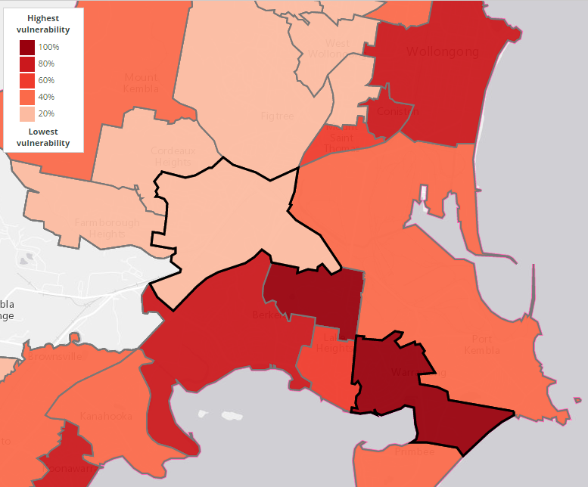
What does the AEDC tell us?
Low developmental vulnerability
High developmental vulnerability
1
2
SES: socio-economic status; ECD: Early child development

Slide 5
What is it about where you live that makes a difference to child development?

Slide 6

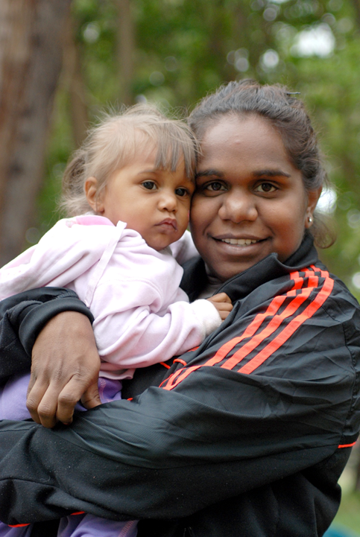

The Project Team
Chief Investigators:
Prof Sharon Goldfeld (VIC)
Prof Ilan Katz (NSW)
Prof Rob Tanton (ACT)
A/Prof Sally Brinkman (SA)
A/Prof Geoff Woolcock (QLD)
Prof Billie Giles-Corti (VIC)
Researchers:
Dr Karen Villanueva (VIC)
Ms Anna Jones (NSW)
Dr Lain Dare (ACT)
Ms Ashleigh Wilson (SA)
Ms Genevieve Smith (QLD)
Ms Ju-Lin Lee (VIC)
Ms Michelle Tennant (VIC)
Ms Rachel Robinson (VIC)
Notes:
KV

Slide 7















The Project Partners
Notes:
ARC Linkage grant
Started data collection in 2015 (3 years)

Slide 8

Based on AEDC data, KiCS is looking at community-level factors: beyond the
child and family environment
State & federal government policies
Exploring community- level factors across five domains
Local Government
Governance domain: Governance structures & policies
Community
Social domain: Social capital, neighbourhood, attachment, crime, trust, safety
Service domain: Quantity, quality, access and coordination of services
Governance domain: Citizen engagement
Socio-economic domain: Community SES
Physical domain: Parks, public transport, road safety, housing
Family
Child
Kids in Communities Study
Goldfeld at al
Social Indicators, 2014

Slide 9
Community-level influences
Domains | Key proposed sub-domains
Physical | Parks and green space, public transport, traffic, walkability, destinations and facilities, housing and density, crime statistics, aesthetics
Social | Social capital, neighbourhood attachment, crime, trust, safety, child friendliness
Socio-economic | Community SES, Community demographics
Service | Quality, quantity, access, coordination
Governance | Citizen engagement, governance structures and policies, partnerships etc
GOLDFELD, S., WOOLCOCK, G., KATZ, I., TANTON, R., BRINKMAN, S., O’CONNOR, E., MATHEWS, T. & GILES-CORTI, B. 2014. Neighbourhood Effects Influencing Early Childhood Development: Conceptual Model and Trial Measurement Methodologies from the Kids in Communities Study. Social Indicators Research, 1-16.

Slide 10
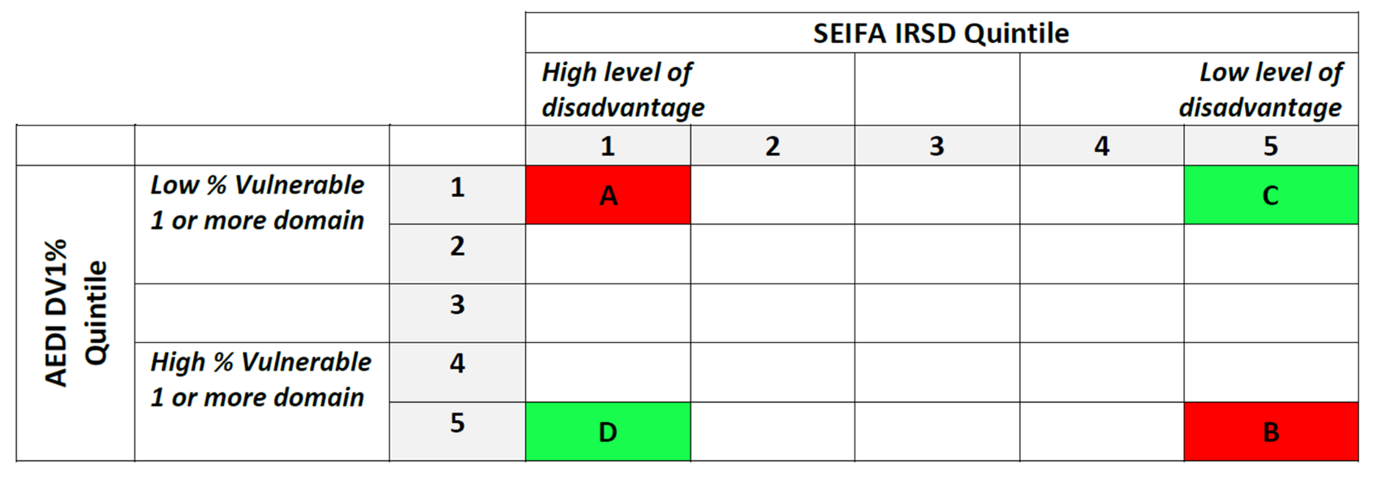
Learning from extremes: off diagonal communities
Off-diagonal positive
Low SES, good ECD
On-diagonal advantaged (+)
High SES, good ECD
On-diagonal disadvantaged (-)
Low SES, poor ECD
Off-diagonal negative
High SES, poor ECD
Tanton, R., Dare, M., Brinkman, S., Corti, B., Katz,I., Woolcock, G., Goldfeld, S. Identifying off-diagonal communities using the Australian Early Development Census results. Social Indicators Research. 2016. Doi: 10.1007/s11205-016-1333-2
SES: socio-economic status; ECD: Early child development
Notes:
Communities with better or worse child development outcomes relative to their socioeconomic status (SES).
SEIFA: Australian Bureau of Statistics Socio-economic index for areas - income, employment – labourers, % occupied dwellings no internet connection, education

Slide 11
An example: Off-and on-diagonal communities
Off-diagonal positive
Low SES, good ECD
On-diagonal disadvantaged (-)
Low SES, poor ECD
1
2
SES: socio-economic status; ECD: Early child development

Slide 12
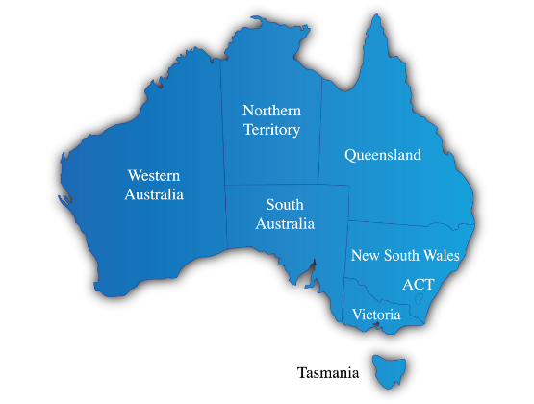
In 2015-2016,
KiCS explored 25 communities in Australia

Slide 13
Measuring the domains
 | Method | Source/s | Type | Governance | Physical | Socioeconomic | Service | Social
1 | Stakeholder interviews | Primary data | Qual¹ | x | x | x | x | x
2 | Parent focus group | Primary data | Qual¹ | x | x | x | x | x
3 | Practitioner focus group | Primary data | Qual¹ | x | x | x | x | x
4 | Policy documents | Primary data | Qual¹ | x | x | x | x
5 | Service survey | Primary data | Quant² |  |  |  | x
6 | Community survey | Primary data | Quant² | x | x |  | x | x
7 | GIS and park audits | Primary data, Existing data | Quant² |  | x |  | x
8 | Service template | Primary data, Existing data | Qual¹/ Quant² |  |  |  | x
9 | Community demographics | Existing data | Quant² |  |  | x
Qual¹: qualitative data (orange); Quant² data” quantitative data (green)
Notes:
3-year project funded by the ARC and other government orgs

Slide 14

Qualitative data

Slide 15


Policy documents
10/community (LGA/‘cluster’)

Slide 16
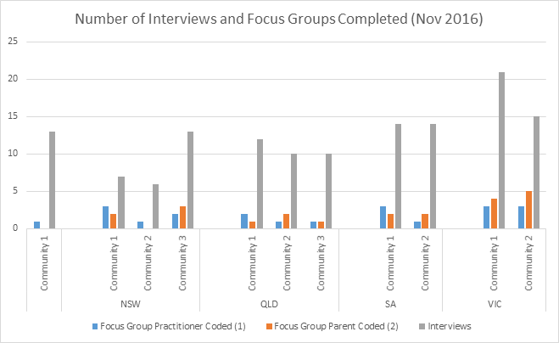

Slide 17
“We’ve got a street out here … and it's quite a long street. There’s quite a big difference between the people here to there. They don’t mix. They very rarely mix unless they're driving past or something.” (Int51)
Notes:
[FG ID 10]
? QUOTE: stigma/ negative generalised trust can’t walk to other end of street; vs we can get there ourselves

Slide 18
Hypotheses for further exploration
SOCIAL
PHYSICAL
SERVICES
Walkability – esp in pockets of disadvantage
Role of stigma
GOVERNANCE
Explore service models:
preschools vs long day care
e.g. C4C/ Best Start in communities
SES
Gentrification
Where are networks beginning? School, Kinder, Playgroup, Maternal and Child Health?
Children’s Hubs vs whole-of-community services
Schools as hubs
Population Growth
Local vs regional structures
Quality and safety of POS e.g. parks
Housing types e.g density of public housing
Hidden versus known disadvantage

Slide 19

Quantitative data

Slide 20
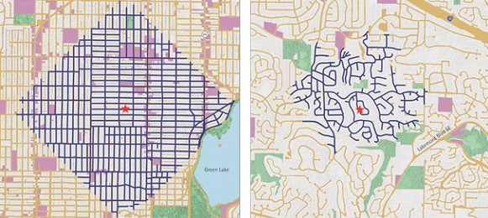

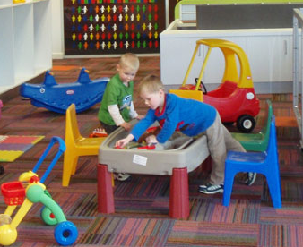
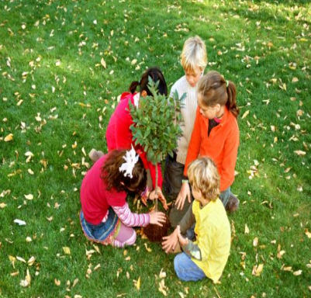
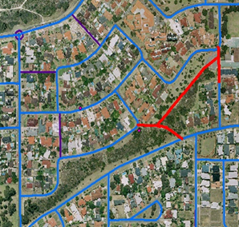
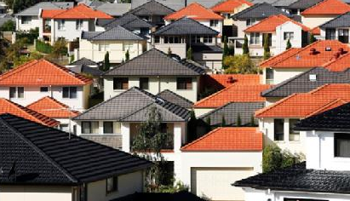
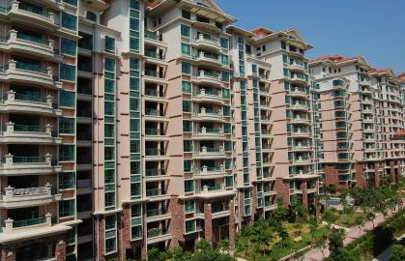


Geographic Information Systems (GIS)
Walkability and cyclability
Traffic
Destinations
Greenness
Crime
Connectivity
Housing
Density
Crime
Aesthetics

Slide 21
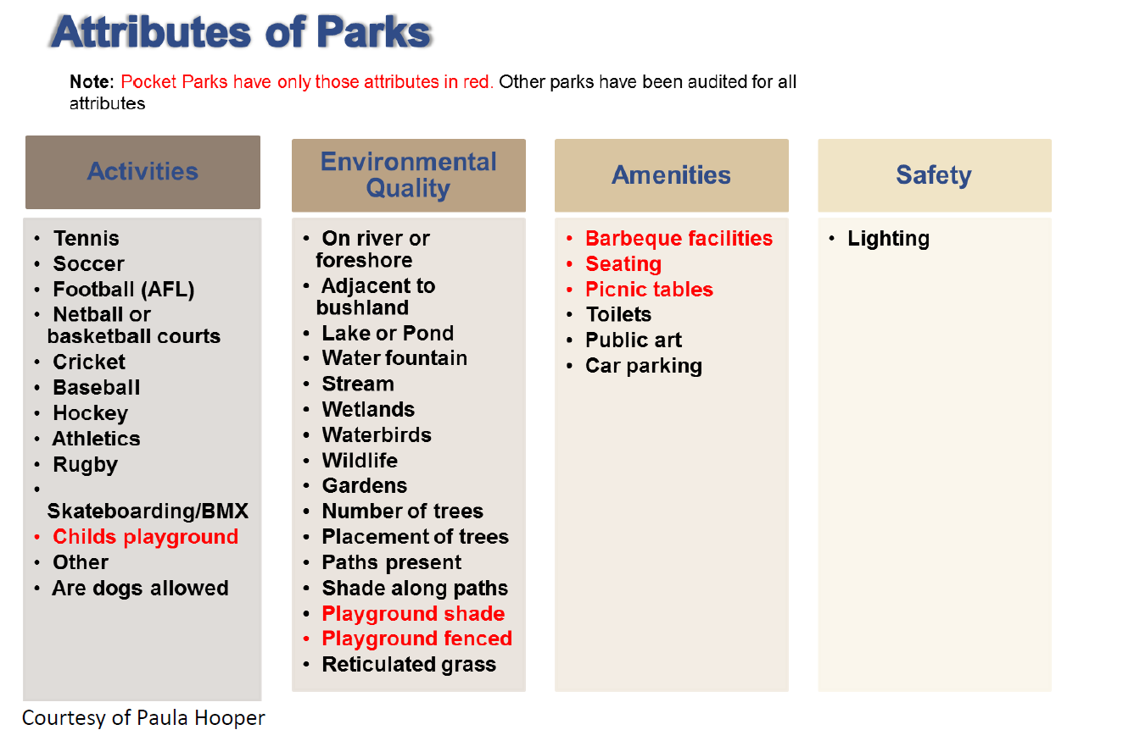
Desktop park auditing

Slide 22

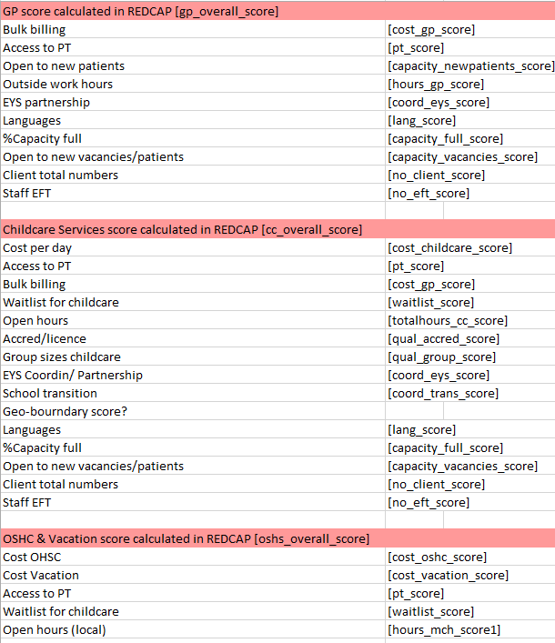
Service information
Network service survey
Service information
1 per/service provider type/community

Slide 23

Community survey
Random addresses
Australian Electoral Commission (AEC)
Mail-out
Wave 1: Pre-notification (online & phone)
Wave 2: Main survey (online, phone, hardcopy)
Wave 3: Final follow-up (online & phone)
Incentives
Online survey
https://redcap.mcri.edu.au/kics

Slide 24
Our approach to analyses
Descriptive analyses for on/off diagonality
Concurrent analyses for quantitative and qualitative data for each domain
Testing hypotheses generated from qual data with quant data
Triangulation of data and affirmation of what’s important
Do they match?
Complex analytic work
If there is a group of variables that emerge do they make sense?
Analytically, what seems to be important for ECD?

Slide 25

Next steps
Set of potential community-level indicators for ECD
Draft manual of measures and methodologies
Research Translation activities:
Community Reports
Local feedback
AEDC Website
Research snapshots
Peer-reviewed papers
Notes:
Indicators: ‘input’ indicators vs outcome focused

Slide 26
Thank you! Please contact us if you have any other comments www.rch.org.au/ccch/kics/
Prof Sharon Goldfeld
KiCS Lead Chief Investigator
sharon.goldfeld@rch.org.au
Dr Karen Villanueva
KiCS Project Coordinator
Karen.Villanueva@mcri.edu.au
The Kids in Communities Study (KiCS) study protocol: A cross-sectional mixed-methods approach 3 to measuring community-level factors influencing early child development in Australia . BMJOpen (accepted Nov 2016)

